Slide 1
Good
God
Free

Slide 2
Sin
Now
Took

Slide 3
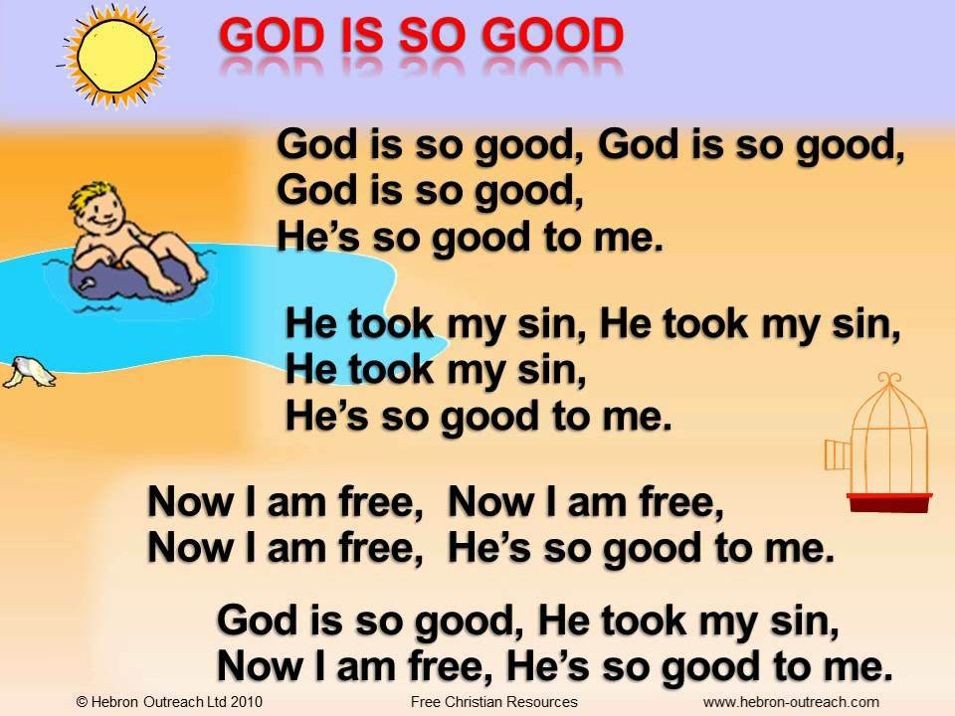

Slide 4
Pray

